Slide 1
Deep learning introduction

Slide 2
ChatGPT
https://poe.com/

Slide 3
Rationale
Provide you with just enough intuition about deep neural networks to start implementing them.
Then learn by doing.

Slide 4
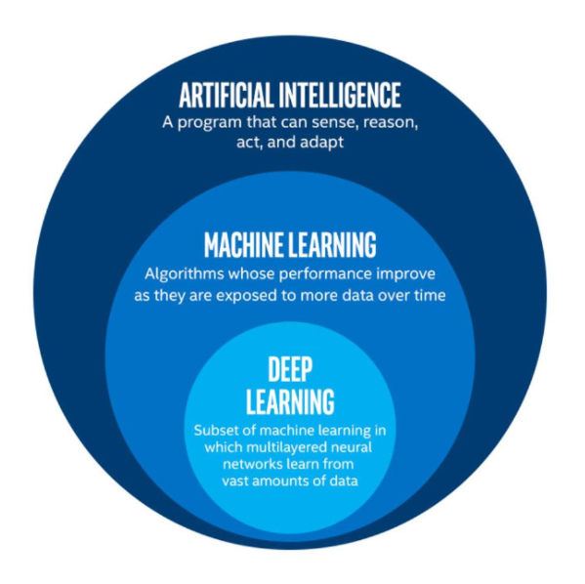

Slide 5
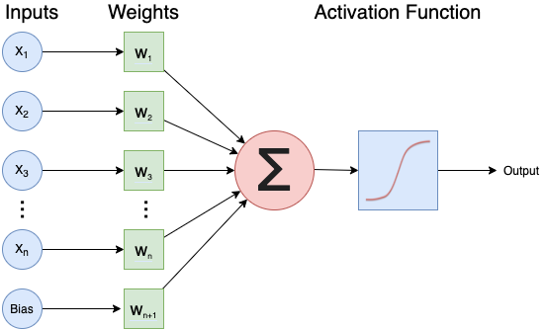
The Neuron
Notes:
x1 … xn and w1 … wn are individual numbers, combined to a weighted sum
The activation function produces the final output of the neuron

Slide 6
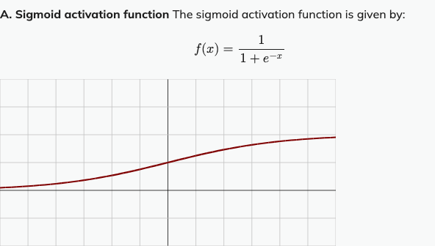
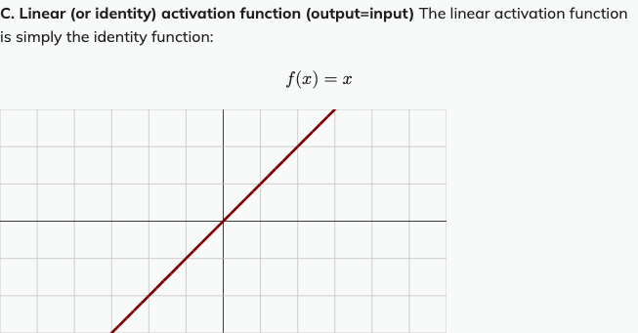
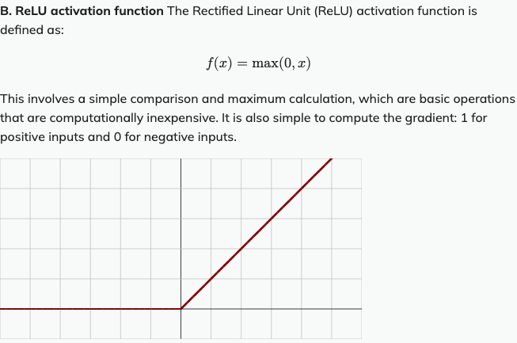
The Activation Function
Notes:
Sigmoid: enforces the activation of a neuron to be between 0 and 1
ReLu: introduces non-linearity in a computationally efficient way.

Slide 7
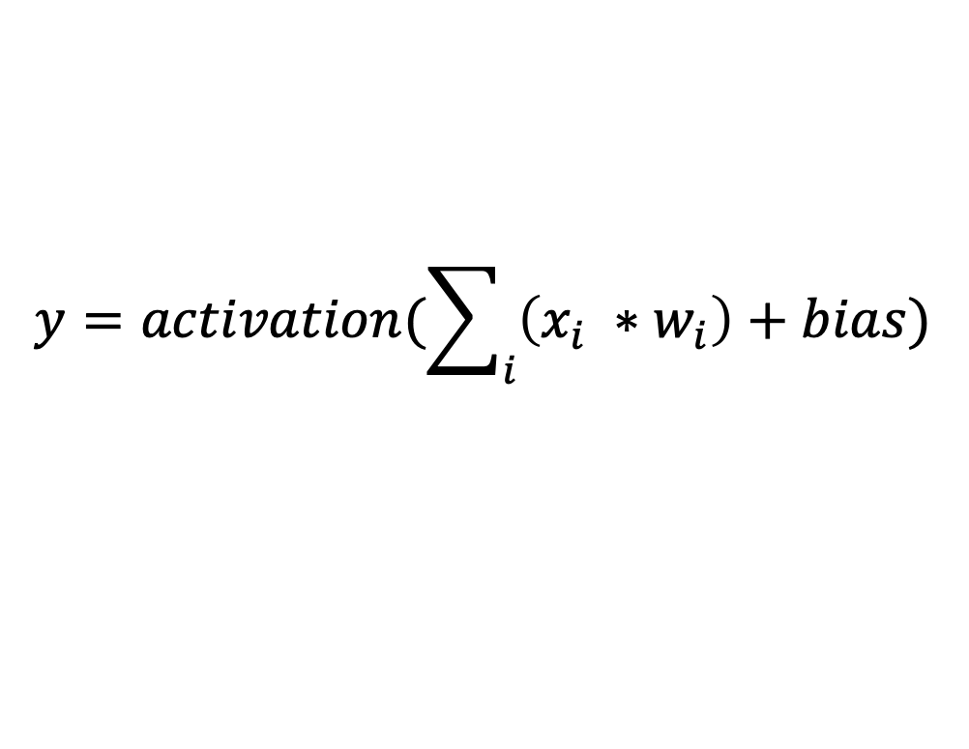
The Neuron
$$y=activation(\sum_{i}{\left(x_{i} ∗w_{i}\right)+bias)}$$
Notes:
x1 … xn and w1 … wn are individual numbers, combined to a weighted sum
The activation function produces the final output of the neuron

Slide 8
GPT-4 explaining what neurons do in GPT
Bills et al. (2023) trained GPT-4 to give explanations of what neurons in another GPT-4 network do:
https://openaipublic.blob.core.windows.net/neuron-explainer/paper/index.html#sec-intro

Slide 9
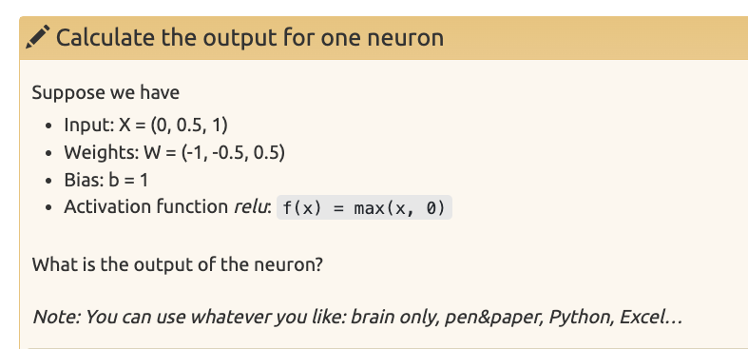
Notes:
Z

Slide 10
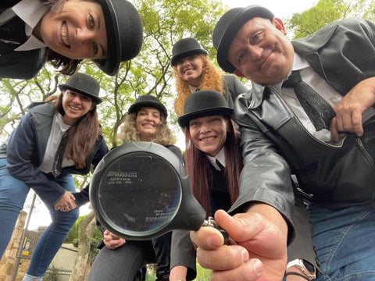
Networks as a team of detectives
Each neuron has a certain expertise, focusing on particular patterns in the evidence (the input data)
Together they make a decision on who is guilty.

Slide 11
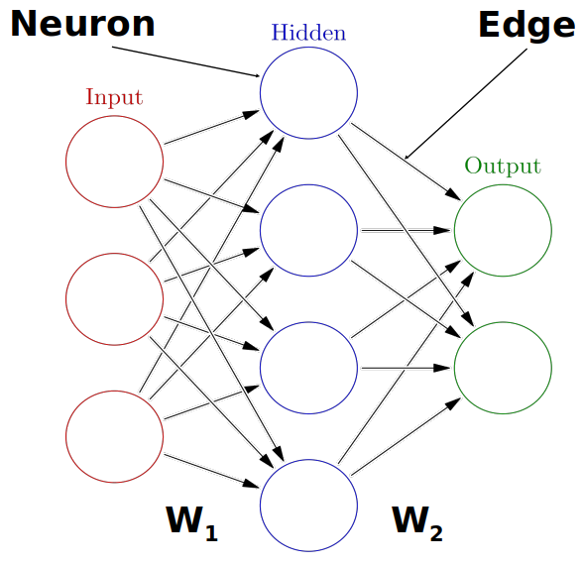
The Neural Network

Slide 12
Why deep neural networks? Intuition.
No hidden layer, simple dataset
No hidden layer, complex dataset
Hidden layer, complex dataset

Slide 13
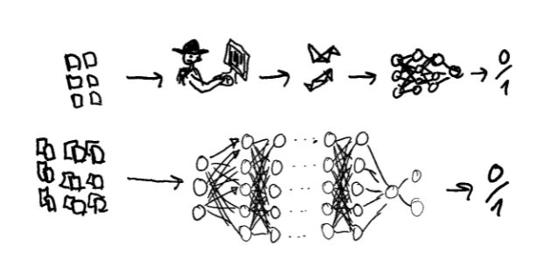
Deep vs shallow neural networks

Slide 14
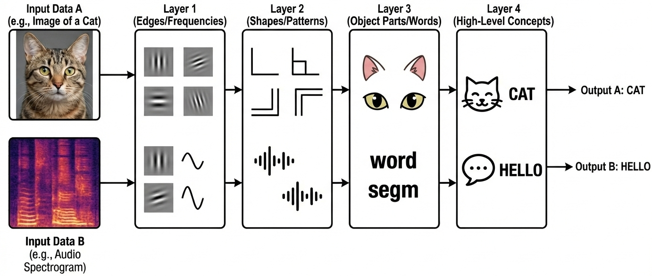

Slide 15
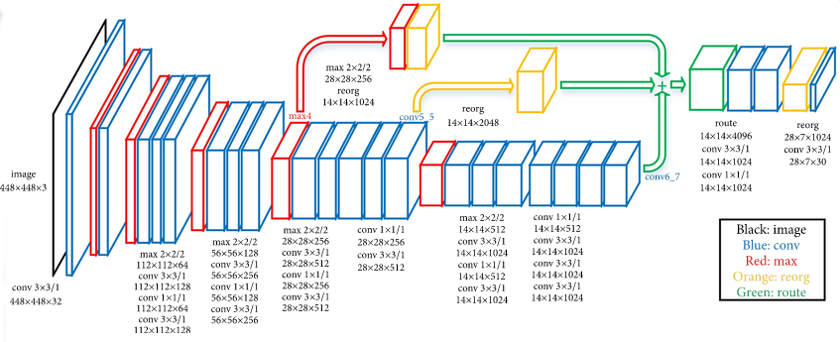
Example deep network
From https://doi.org/10.48550/arXiv.1512.03385

Slide 16
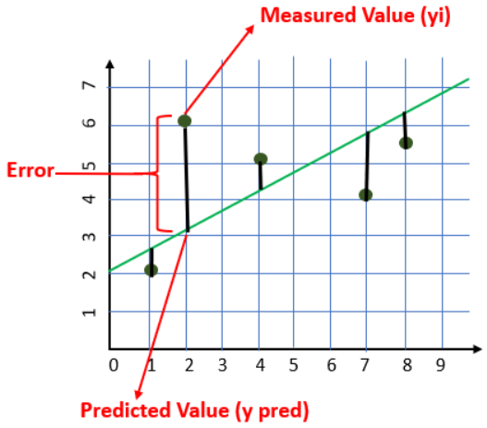
How do neural networks learn?
Notes:
The loss function quantifies the error.

Slide 17
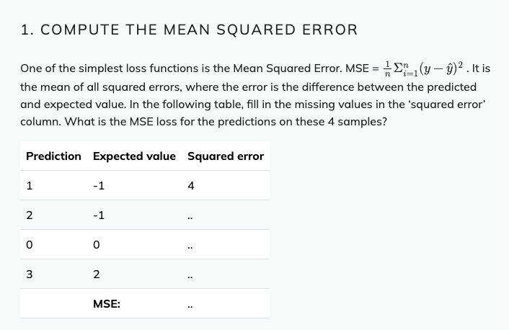

Slide 18
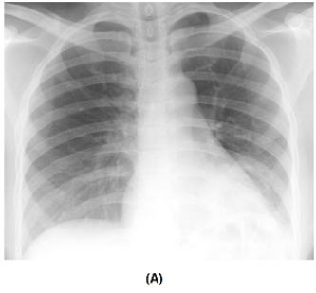
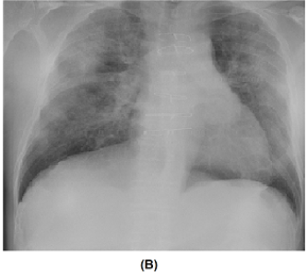
Pattern/object recognition
COVID-Net: A Tailored Deep Convolutional Neural Network Design for Detection of COVID-19 Cases from Chest X-Ray Images, L.Wang et al., 2020, https://arxiv.org/pdf/2003.09871
Notes:
A: non-Covid infection, B: Covid infection

Slide 19
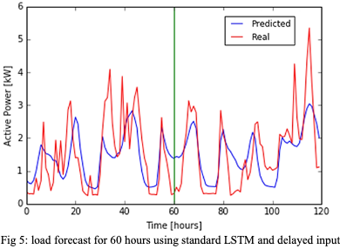
Example: energy load forecast
Building Energy Load Forecasting using Deep Neural Networks, D.L. Marino et al., 2016

Slide 20
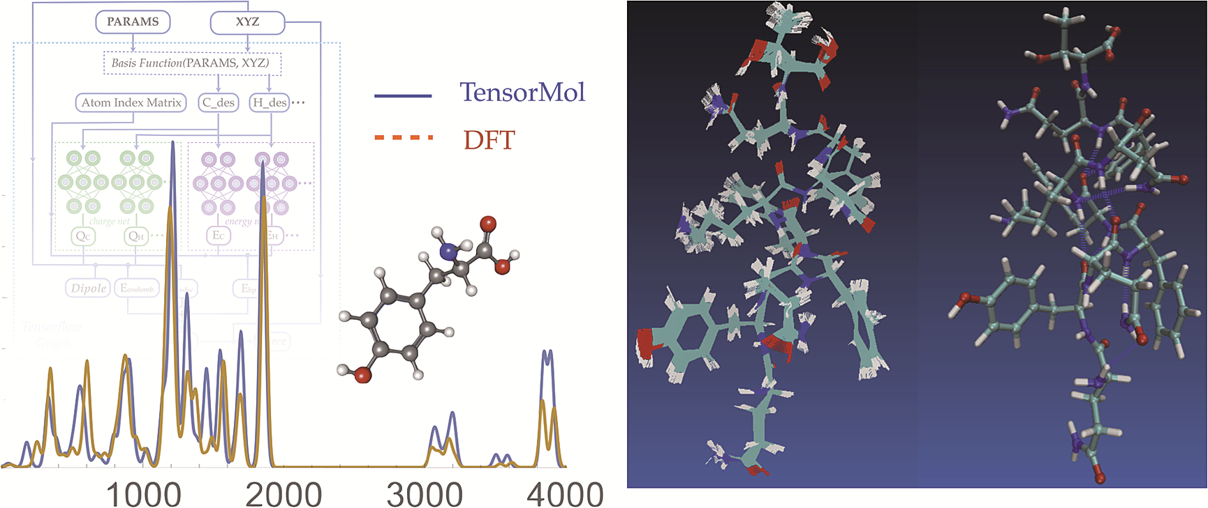
Example: molecular dynamics
The TensorMol-0.1 model chemistry: a neural network augmented with long-range physics, J.E. Herr, 2018, https://doi.org/10.1039/c7sc04934j

Slide 21
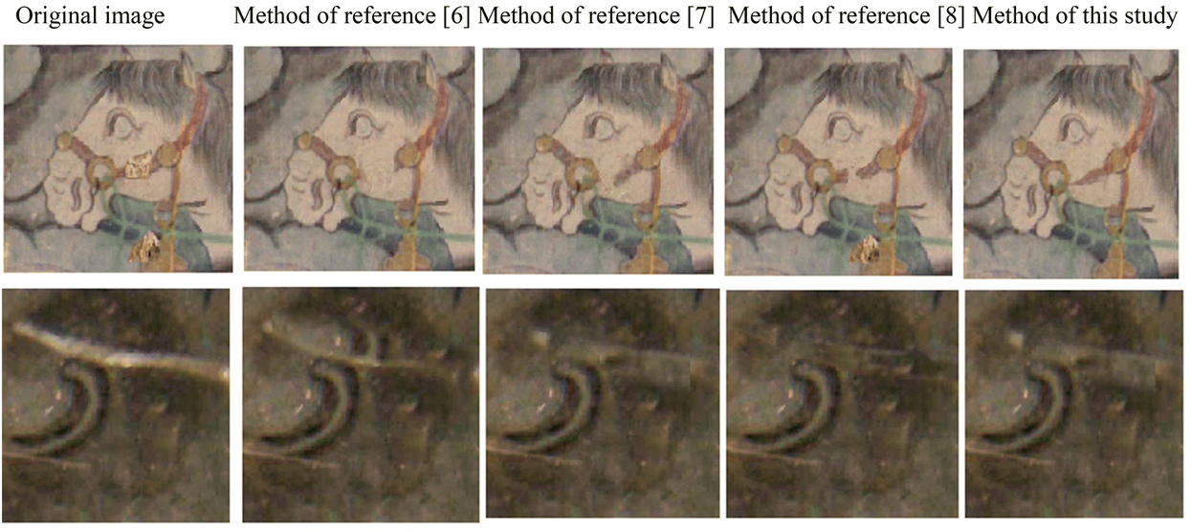
Processing images
Ancient mural restoration based on a modified generative adversarial network, J. Cao et al., 2020, https://doi.org/10.1186/s40494-020-0355-x

Slide 22
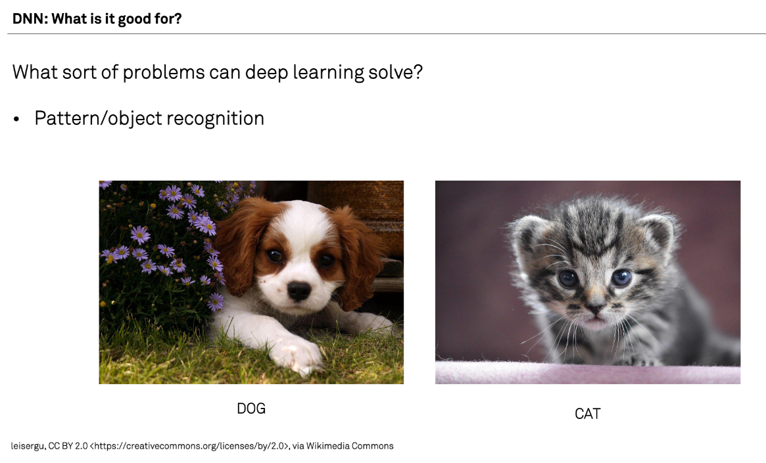

Slide 23
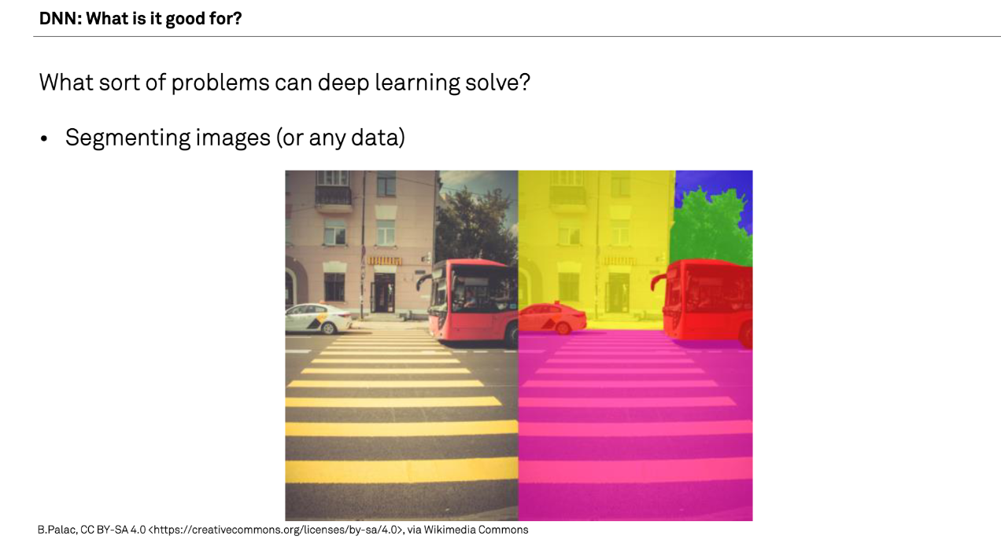

Slide 24
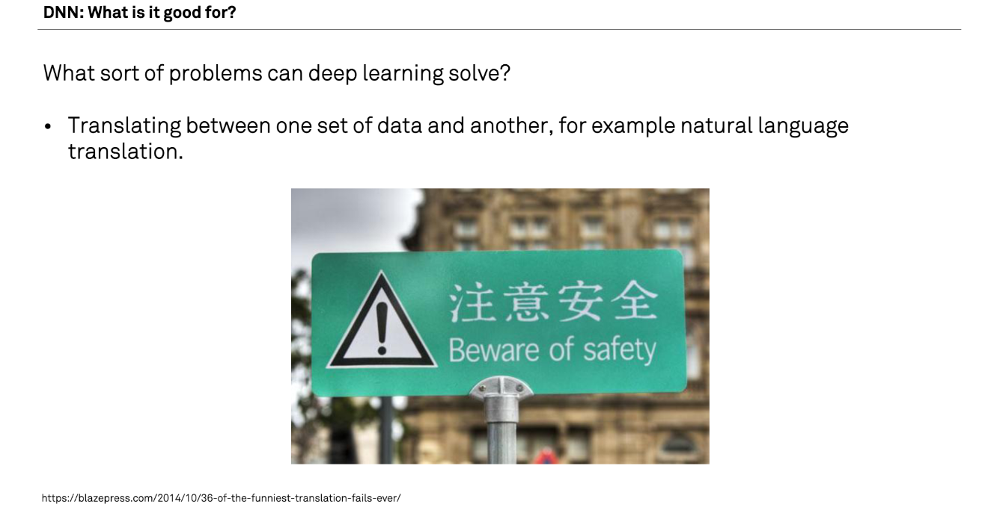

Slide 25
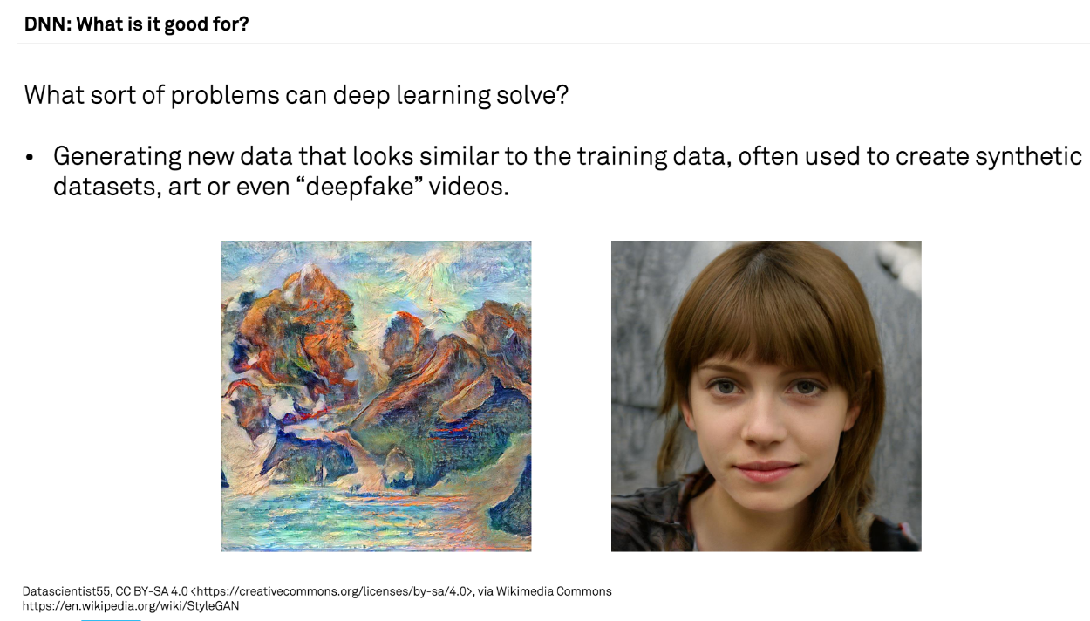
DNN: What is it good for?
What sort of problems can deep learning solve?
Generating new data that looks similar to the training data, often used to create synthetic datasets, art, or deepfake videos. A recent famous example: chatGP

Slide 26
What are examples that you have of deep learning applied to research?

Slide 27
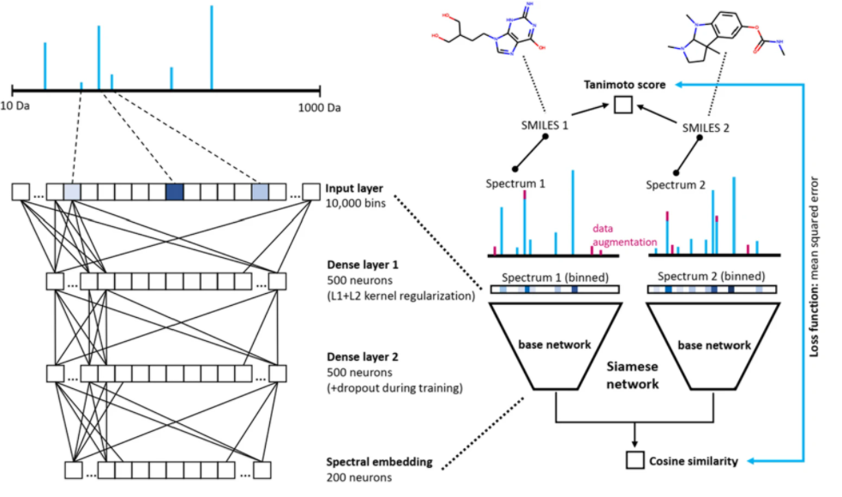
Example of Deep Learning applied to Research: MS2DeepScore: a novel deep learning similarity measure to compare tandem mass spectra

Slide 28
Problems deep learning cannot solve
Any case where only a small amount of training data is available.
Tasks requiring an explanation of how the answer was arrived at.
Classifying things which are nothing like their training data.

Slide 29
Problems for which DL is inefficient
Logic operations, such as computing totals, averages, ranges etc.
Modelling well defined systems, where the equations governing them are known and understood.
Basic computer vision tasks such as, decreasing colour depth or blurring an image.

Slide 30
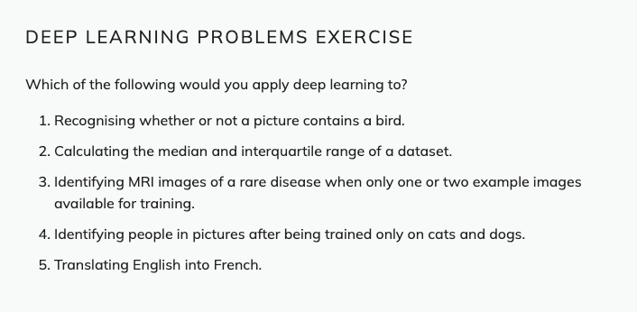

Slide 31
Deep learning workflow
Formulate/outline the problem
Identify inputs and outputs
Prepare data
Choose a pre-trained model or build a new architecture from scratch
Choose a loss function and optimizer
Train the model
Perform a Prediction
Measure Performance
Tune hyperparameters
Share model

Slide 32
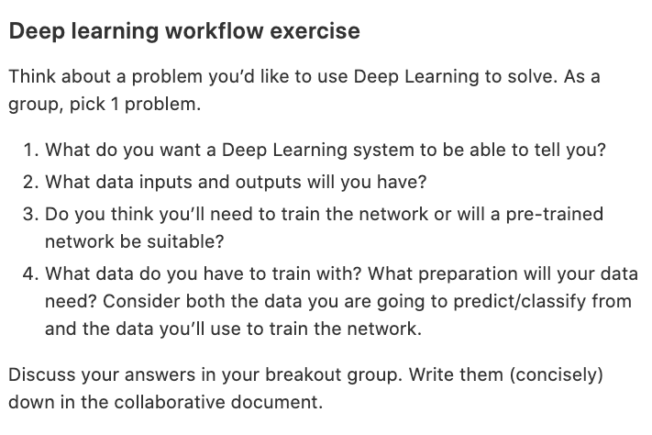

Slide 33
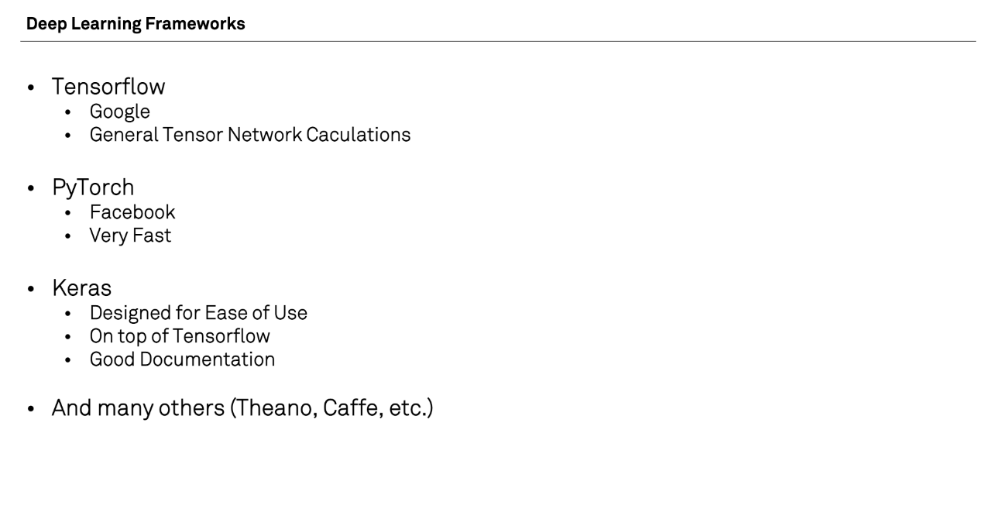

Slide 34
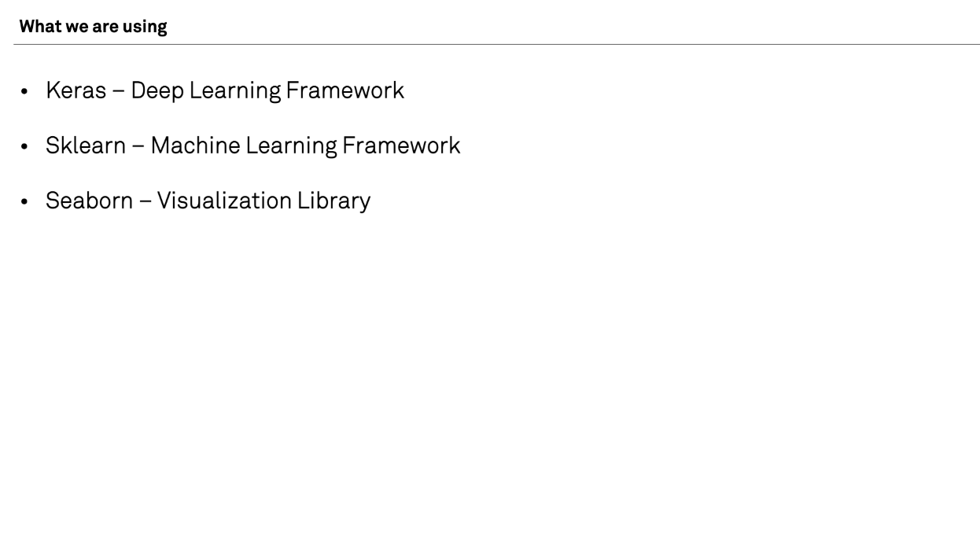

Slide 35
What have we learned?
What deep learning is
How neural networks work
When to apply deep learning
Applying deep learning with the ‘deep learning workflow’

Slide 36
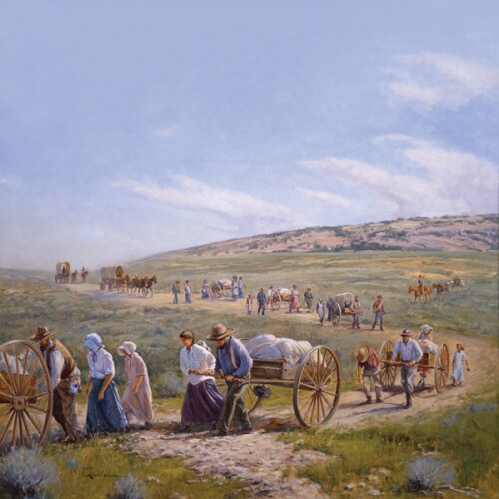
You are pioneers

Slide 37
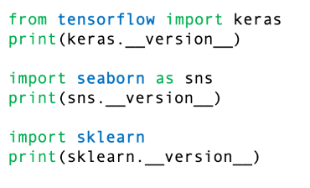
Check versions

Slide 38
Next steps
Practice!
  For example try a Kaggle competition: https://www.kaggle.com/competitions
Read/watch blogs and videos
  For example: 2-minute papers
Fast.ai course: making neural nets uncool again
  https://course.fast.ai/
Try a quick and dirty approach first, then optimize
Get acces to a GPU
  If experiments take seconds instead of 20 minutes, you can iterate over hypothesis -> experiment -> conclusion much much quicker

